Slide 1

Enabling Developers to Create Native iOS, Android, Mac, & Windows apps in C#
Allan Pead
apead@adsoftsystems.co.za
www.adsoftsystems.co.za
@adpead
Notes:
Xamarin Introduction!

Slide 2

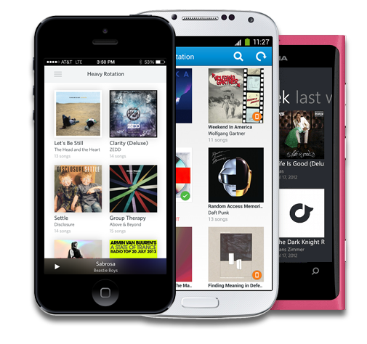

What is Xamarin?
Xamarin enables developers to reach all major mobile platforms!
Native User Interface
Native Performance
Shared Code Across Platforms
C# & .NET Framework

Slide 3
Mobile Development Approaches
Notes:
Let’s talk about the state of mobile development today

Slide 4
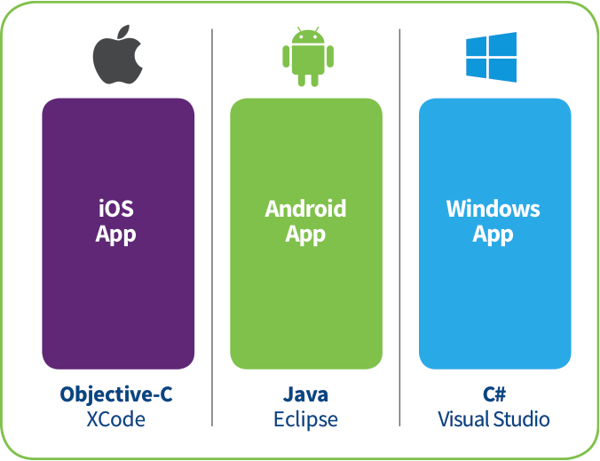
Silo’d Approach
Build Apps Multiple Times
Multiple Teams
Multiple Code Bases
Different toolsets
Notes:
Multiple Teams
Multiple Code Bases
Expensive & Slow
Positive = Great apps delivered to user’s platform
Negative = Development hampered by multiple code bases & fragmentation

Slide 5
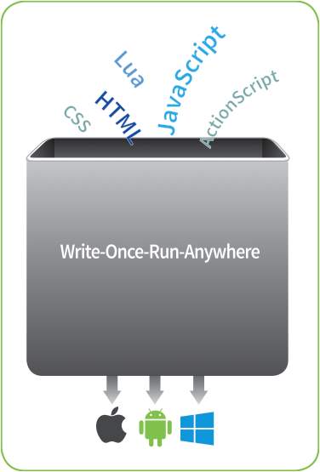
Write Once, Run Anywhere Approach
Lowest common denominator
Browser fragmentation
Developing & designing for 1 platform, happen to get other platforms
Black Box
Notes:
Unhappy Users
Unhappy Developers
Increase in Abandoned Apps
Limited to what is implemented

Slide 6
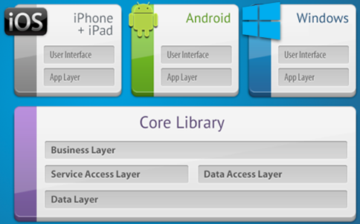
Xamarin’s Unique Approach
Native User Interface
Native Performance
Shared code across platforms
C# & .NET Framework
Full API Coverage
Notes:
UI build natively per platform, leveraging C#
C# + XAML
C# + XML
C# + XIB
One shared app logic code base, iOS, Android, Mac, Windows Phone, Windows Store, Windows

Slide 7
Why C#?
Notes:
Let’s talk a bit about C# and why it is awesome.

Slide 8
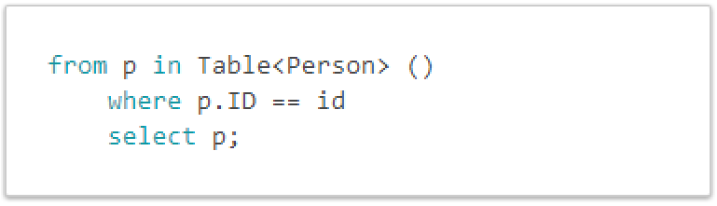
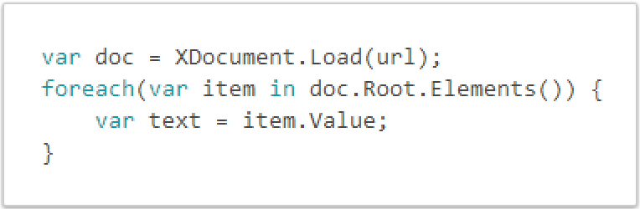
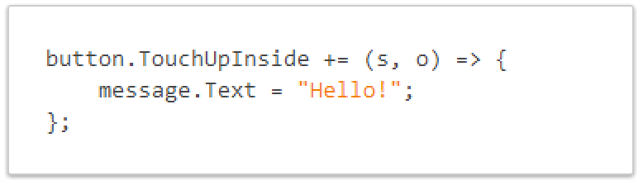
C# Is Awesome
LINQ Support
Work With XML Easily XDocument
Event Handling & Delegates
Notes:
Statically typed so you avoid a pitfall of errors that afflict other languages.
Use LINQ in your Xamarin projects to query, filter and select data from in-memory arrays, or from databases such as SQLite.
Parsing XML is easy
Setting up event handling is a breeze
Intellisense, lambdas, etc. are all awesome.

Slide 9

C# Is Awesome – JSON Made Easy
Json.NET offers simple conversions to and from JSON strings and .NET objects, with SerializeObject and DeserializeObject methods.
Notes:
Use your favorite libraries like Json.NET!

Slide 10
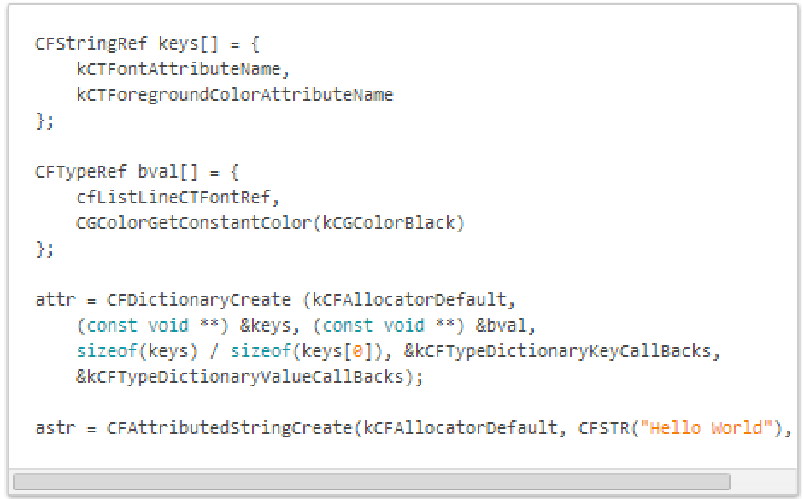
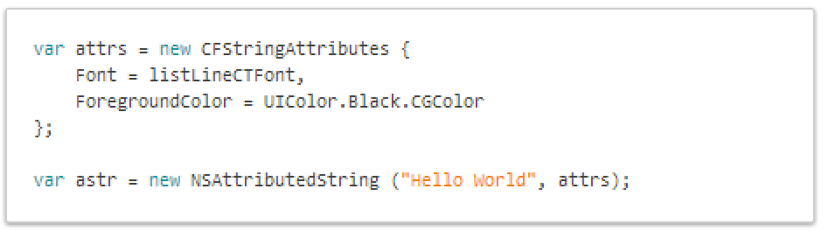
See the Difference – Attributed Strings
Objective-C
C# with Xamarin
Notes:
Here is an example of creating an attributed string.
Take advantage of C# features and set properties easily

Slide 11
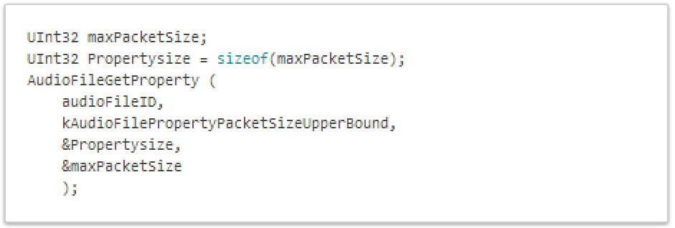

Probing for properties on an AudioFile
Objective-C
C# with Xamarin
Notes:
Here we are looking for the PacketSizeUpperBound, 1 line of code

Slide 12
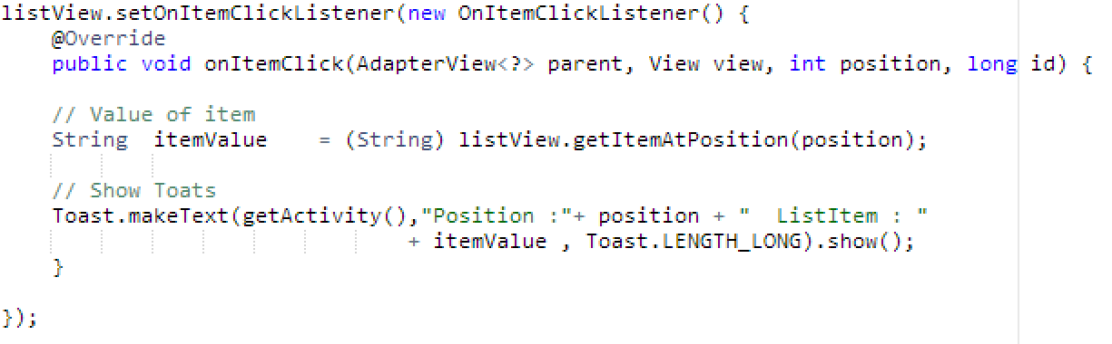
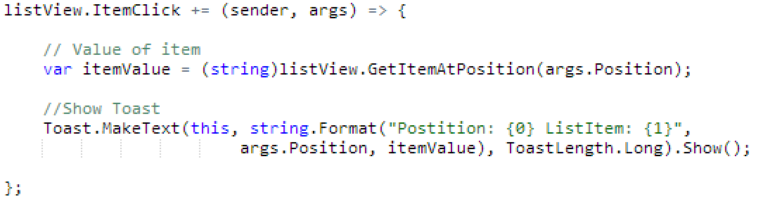
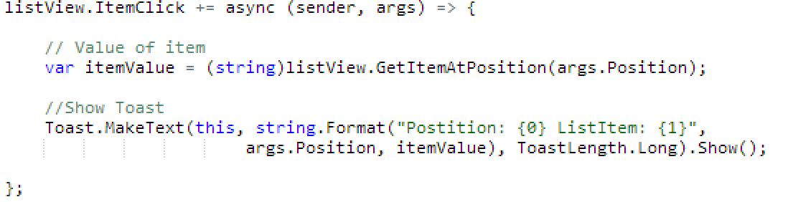
See the Different – Android ItemClick
Java
C# with Xamarin
C# & Async with Xamarin
Notes:
Here we can see how easy it is just to do a += for an event and not have to implement a bunch of listeners every time. Easy to read, string.Format, using args, etc.
In fact we can make this call Async/Await by just adding async to the delegate!

Slide 13
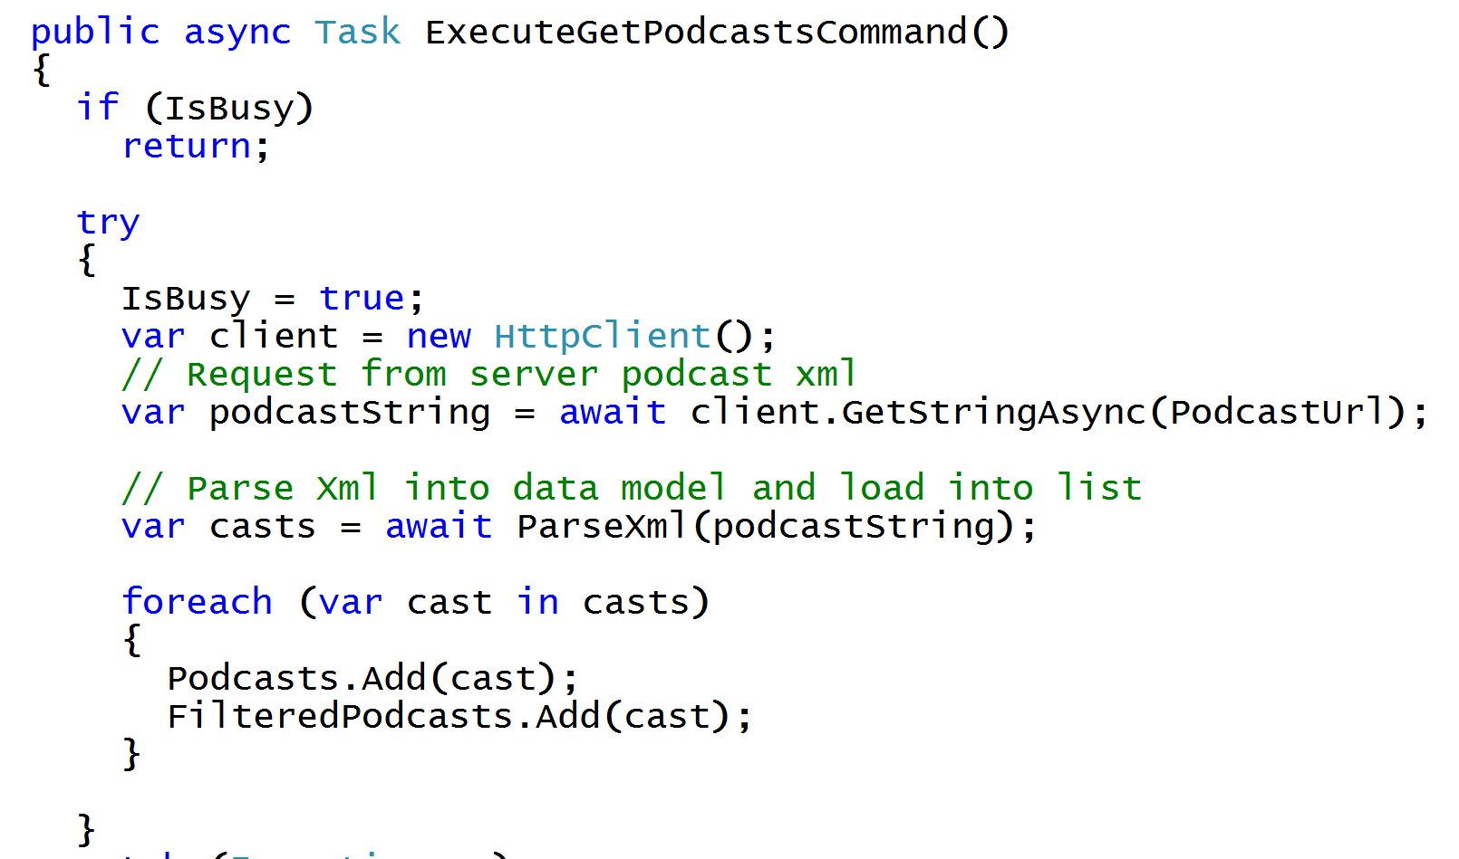
Async/Await
Write Beautiful & Maintainable Code
Notes:
The async and await keywords in C# 5.0 now available to Xamarin developers make asynchronous programming incredibly pleasant.
You end up with code that is much more linear and much easier to understand.
The compiler does a lot of magic for you which simplifies your code and your life.

Slide 14
Why Xamarin?
Notes:
Let’s talk a bit about why you would choose Xamarin as your development platform.

Slide 15

Write Everything in C#
iOS, Android, Windows, Windows Phone, Mac
2.5+ Billion Devices!
Notes:
Take advantage of everything great about C# and now write code that can be shared across all platforms
iOS
Android,
Mac
Windows (WPF, Store, Phone, ASP.NET, etc)

Slide 16
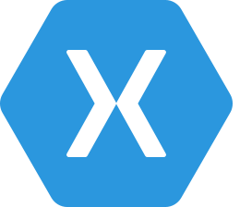
Xamarin History Over a Decade of Enterprise Production Use
500,000+ Developers
100+ Partners
100+ Components
Reach 200,000
Developer
Mark
2000
2001
2003
2009
2011
2012
2013
Ximian Founded
Mono
Started
Ximian Acquired by Novell
First iOS product (now Xamarin.iOS) launches
Xamarin Founded
First Release of Xamarin.Android
First release of Xamarin.Mac
Launch Partner Program
Xamarin 2.0
Component
Store
Evolve 2013
Xamarin Test
Cloud
Microsoft Partnership
Notes:
Full History of Xamarin

Slide 17
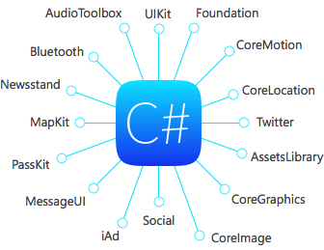
100% API Coverage
Anything you can do in Objective-C or Java can be done in C# and Visual Studio with Xamarin!
Notes:
Xamarin offers 100% API coverage on iOS and Android
If you want to do something specific on a platform it is all available
NFC, iBeacon, WiFi, Bluetooth, you name it the API is available
Xamarin beautiful bindings for every API in Android and iOS

Slide 18
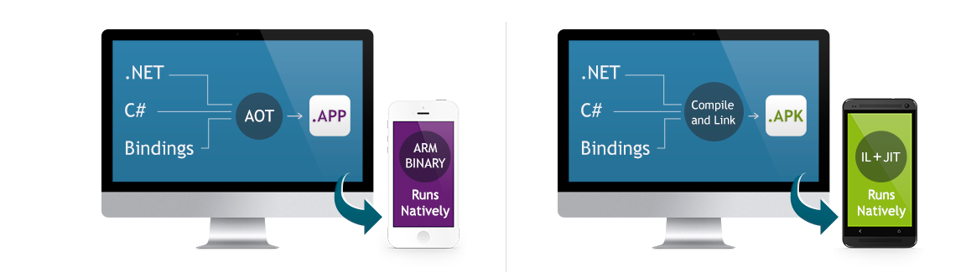
Native Performance
Xamarin.iOS does full Ahead Of Time (AOT) compilation to produce an ARM binary for Apple’s App Store.
Xamarin.Android takes advantage of Just In Time (JIT) compilation on the Android device.
Notes:
There is no compromise on performance.
Xamarin apps look and feel native because they are native.

Slide 19



Always Up to Date
Always up-to-date with the latest APIs from Apple and Google.
Same-day support:
iOS 5
iOS 6
iOS 6.1
iOS 7
Notes:
Apple has a developer preview where Xamarin has alphas ready. Google does not offer this.
Android versions are usually 4 to 8 weeks out for a stable release, but alphas and betas are usually earlier.
Xamarin realizes how important having iOS ready because within 24 hours a large portion of iOS users upgrade
Android on the other hand is much different. After 4 months on the market Android 4.4 only had 1% adoption

Slide 20
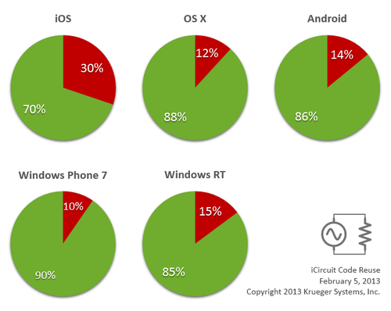

Code Sharing: Accelerate Development
Up to 90% Code Reuse
Leverage existing libraries
NuGet Support
Code-sharing stats from iCircuit, built with Xamarin and featured on the App Store.
Source: http://praeclarum.org/post/42378027611/icircuit-code-reuse-part-cinq
Notes:
iCircuit is made by Frank Krueger, a long time Mono & Xamarin developer.
Sharing code lead to 70 to 90% code reuse across platforms speeding up development
Real-time circuit simulator and editor used to design analog and digital circuits
http://praeclarum.org/post/42378027611/icircuit-code-reuse-part-cinq

Slide 21
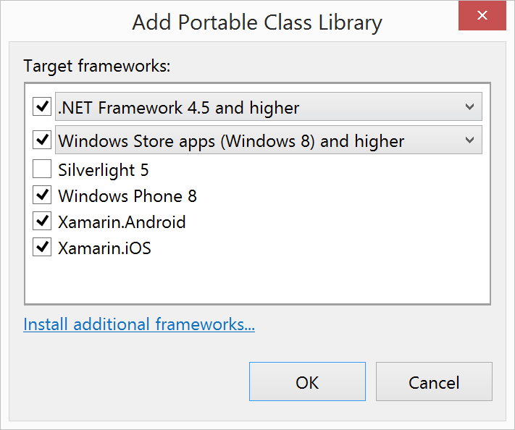
Portable Class Libraries
1 Assembly
Multiple Platforms
Including:
Xamarin.Android
Xamarin.iOS
Notes:
Portable Class Libraries are awesome!
You can write all of your C# code in one assembly and share across all platforms
Before the Xamarin & Microsoft Partnership PCLs were limited ONLY to Windows Platforms
Now add official support to create and use PCLs in Visual Studio and Xamarin Sudio

Slide 22
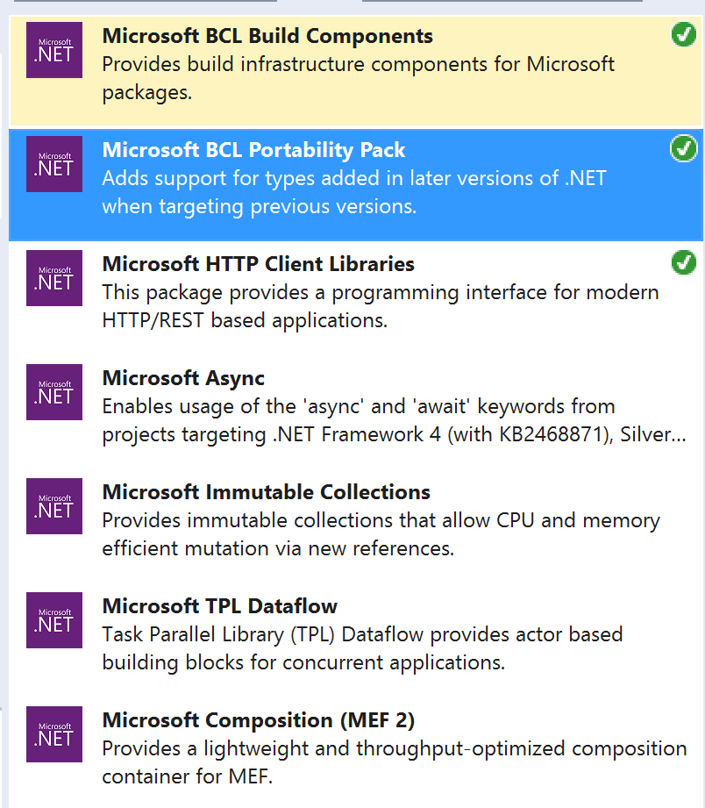
Portable Class Libraries Features
Centralized Code Sharing
How you expect it to work
Debug seamlessly into and out of PCL
Project/Assembly Sharing
NuGet
Notes:
Centralize all code how you want it to work and share across platforms
Take advantage of NuGet to create and use libraries to your projects
Easier to Create and Easier to consume in apps
Create small reusable PCLs to share across all of your projects

Slide 23
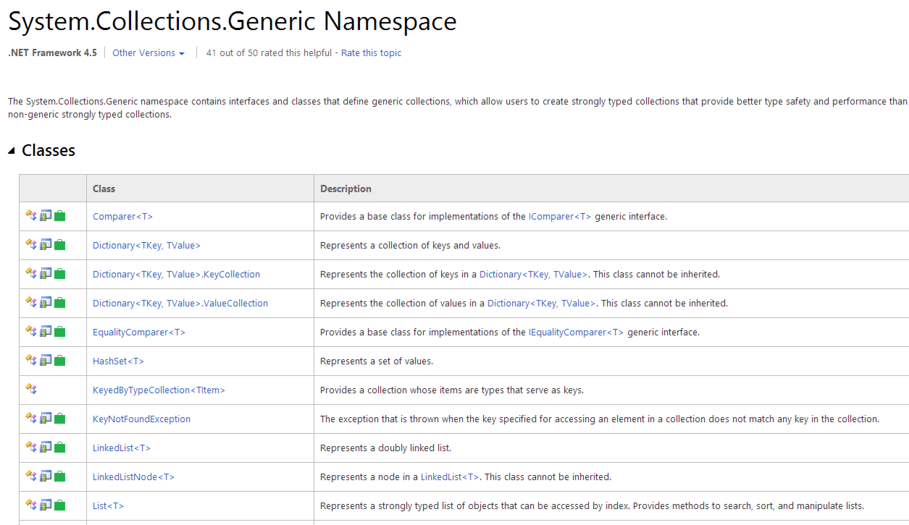
PCLs – Well Documented
Notes:
PCLs have amazing documentation on MSDN already.
As you can see here the 2nd icon is the “PCL Library” icon which tells you what is available
Remember PCLs are a subset of the .NET library because they are platform independent so not all APIs will be available, for example here: KeyedByTypeCollection<TItem> is not available in PCL
Often a NuGet will fill in the gaps, such as PCLStorage for IsolatedStorage across platforms

Slide 24


Microsoft and Xamarin Partner Globally
With Xamarin, developers combine all of the productivity benefits of C#, Visual Studio 2013 and Windows Azure with the flexibility to quickly build for multiple device targets.”
S. Somasegar, Corporate Vice President, Microsoft
Notes:
Major announcement at the end of 2013:
Truly Portable Class Libraries
Support for VS 2013
Special offers for MSDN Subscribers
20 City Roadshow!

Slide 25






Distribute Everywhere
A Xamarin app is an app, distribute it everywhere
Notes:
Compiles down to APK or IPA that you can distribute anywhere, any store.
Or even internal enterprise

Slide 26
Products
Notes:
Xamarin offers many products from the core Xamarin.iOS and Xamarin.Android development to tools to speed up development such as the Component Store and .NET Mobility Scanner

Slide 27


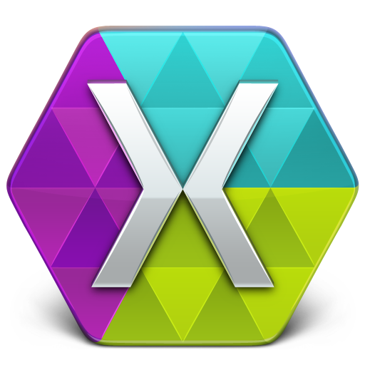





Xamarin for
Visual Studio
Xamarin.iOS
Xamarin Studio
Xamarin.Android
Xamarin Test Cloud
Xamarin.Mac
Component Store
.NET Mobility Scanner
Notes:
High level vies of all the products that Xamarin currently offers, let’s take a look deeper.

Slide 28
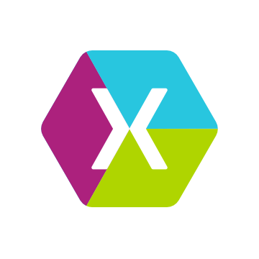

Development Environment
Xamarin Studio
PC or Mac
Visual Studio Plugin
VS 2010/2012/2013
Notes:
Xamarin Studio
PC -> Android
Mac -> iOS, Android, Mac
Visual Studio: iOS, Android Windows

Slide 29
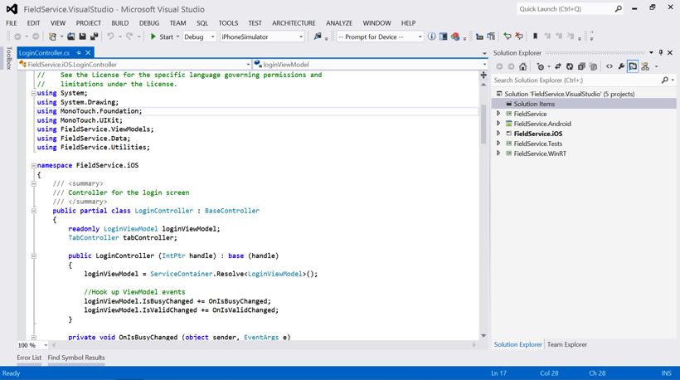
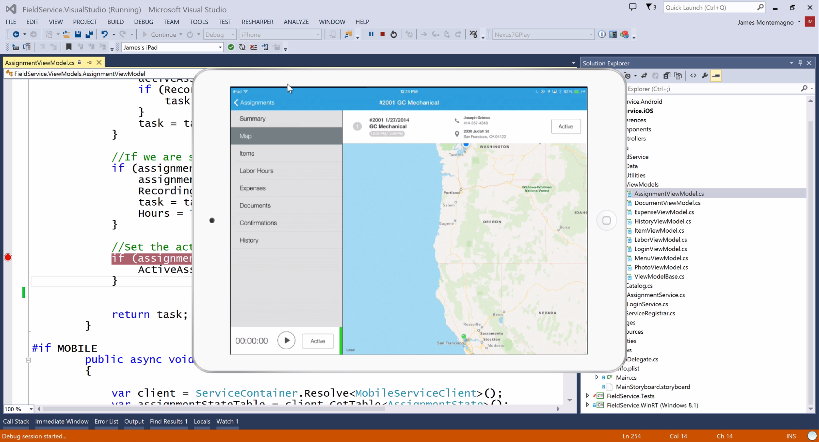



Visual Studio Integration
A single solution:
iOS
Android
Windows Phone
Windows Store
Leverage the entire Microsoft ecosystem:
ReSharper
Team Foundation Server
Your favorite code coverage and profiling tools
Notes:
Additionally Supports Visual Studio 2010, 2012, & of course 2013
Additionally support desktop apps on Windows: WPF, ASP.NET, Silverlight, WinForms!
The same Solution & Projects open in BOTH Xamarin Studio and Visual Studio!

Slide 30
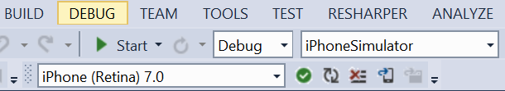
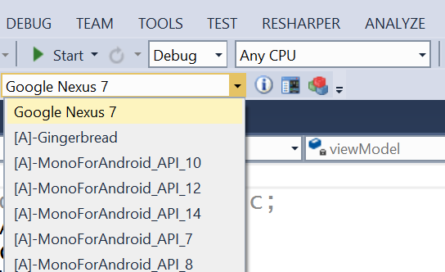
Visual Studio Integration
Debug to:
Emulators
Devices
Integrated into toolbar
Status
Logs
List of devices
Just Click Start Debugging!
Notes:
Connect to Mac build host for iOS development
Show list of all iOS devices and Simulators to debug on
Shows all Android devices and emulators
X86, Arm, Genymotion..
Take advantage of all debugging power of VS

Slide 31
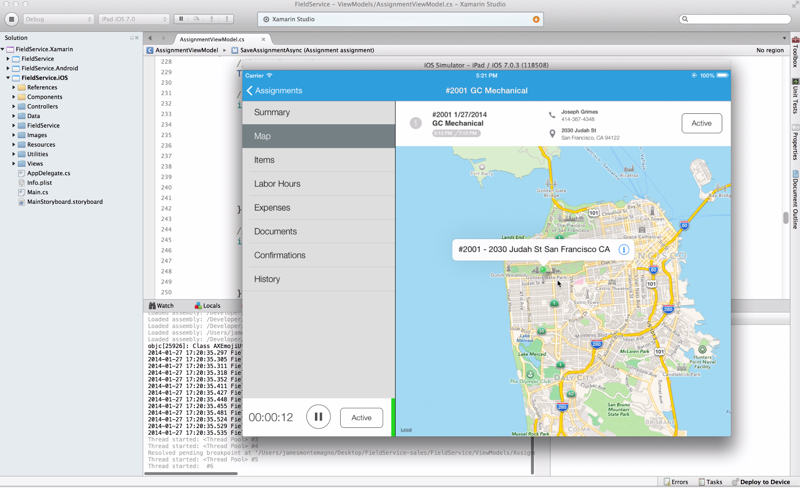
Xamarin Studio
Optimized for cross-platform mobile development
Explore native APIs with code completion
World class Android and iOS designers
Powerful debugging on simulator or device
Notes:
Xamarin Studio is available for Android development on the PC.
Xamarin Studio on Mac offers: Android, iOS and Mac development
World Class IDE with great features:
Code Analysis
Upload to Test Flight
Git & Subversion Integration
Code Completion
Code Navigation
Easy transition from Visual Studio
The same Solution & Projects open in BOTH Xamarin Studio and Visual Studio!

Slide 32
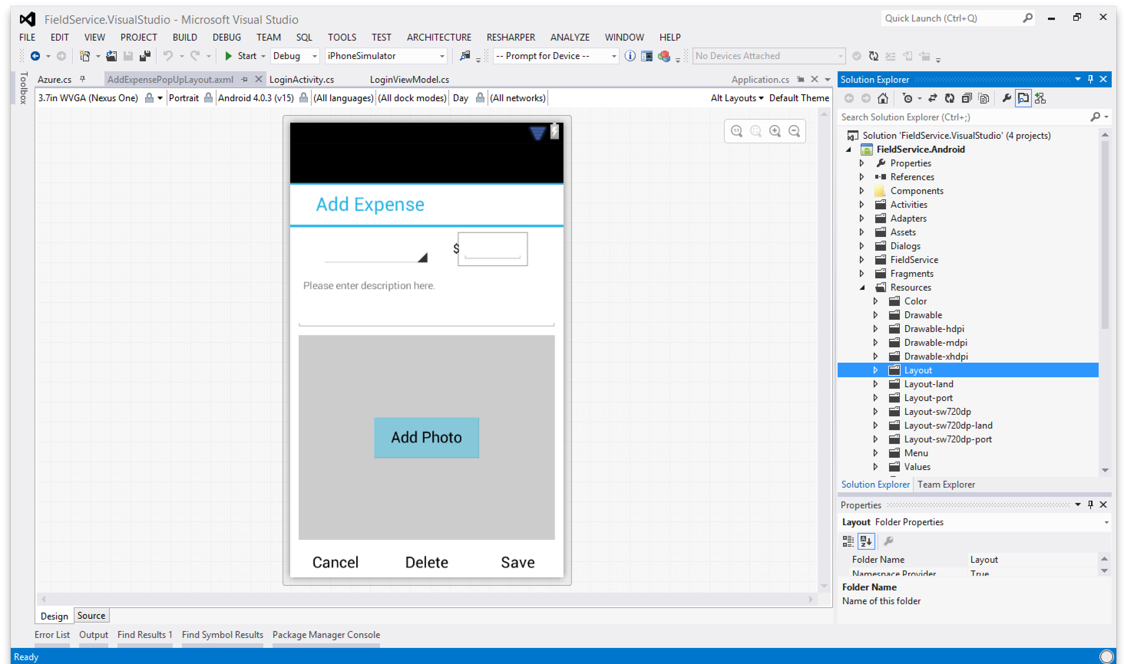
Android Designer
Worlds best Android designer
Available in:
Xamarin Studio
Visual Studio
Create UI with drag & drop simplicity
Target multiple screen sizes, resolutions and Android versions
Layouts saved in standard Android XML files
Notes:
State of the art features:
View different Themes
View different device sizes
Multi-view editing!

Slide 33
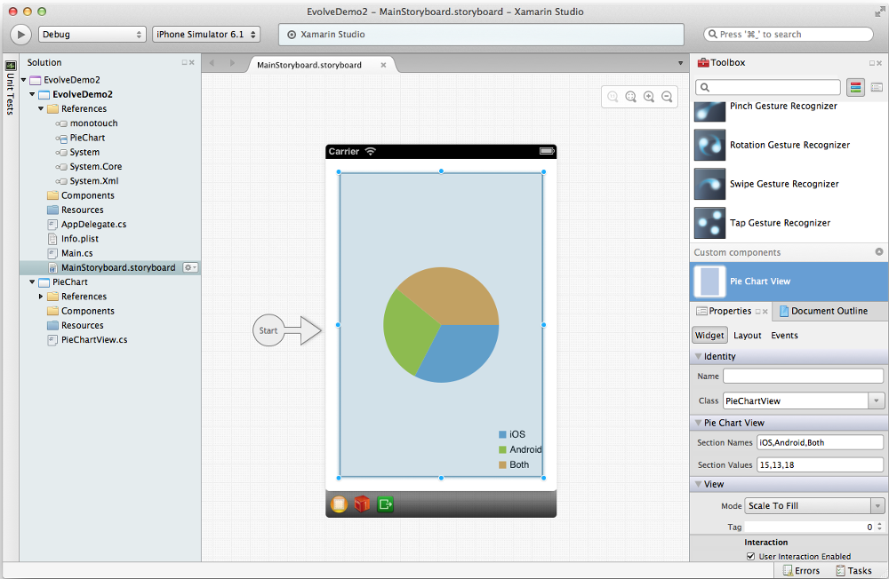
iOS Designer
World’s first iOS Designer available in Xamarin Studio (and soon Visual Studio)
Follows familiar Visual Studio designer idioms
Supports all UIKit elements
Edit custom and 3rd party components
Live preview of changes to properties

Slide 34
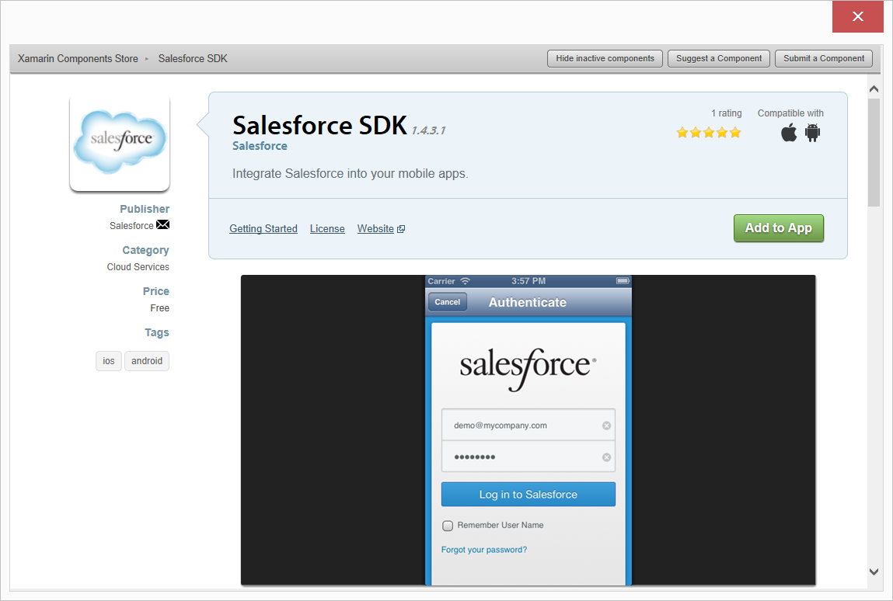
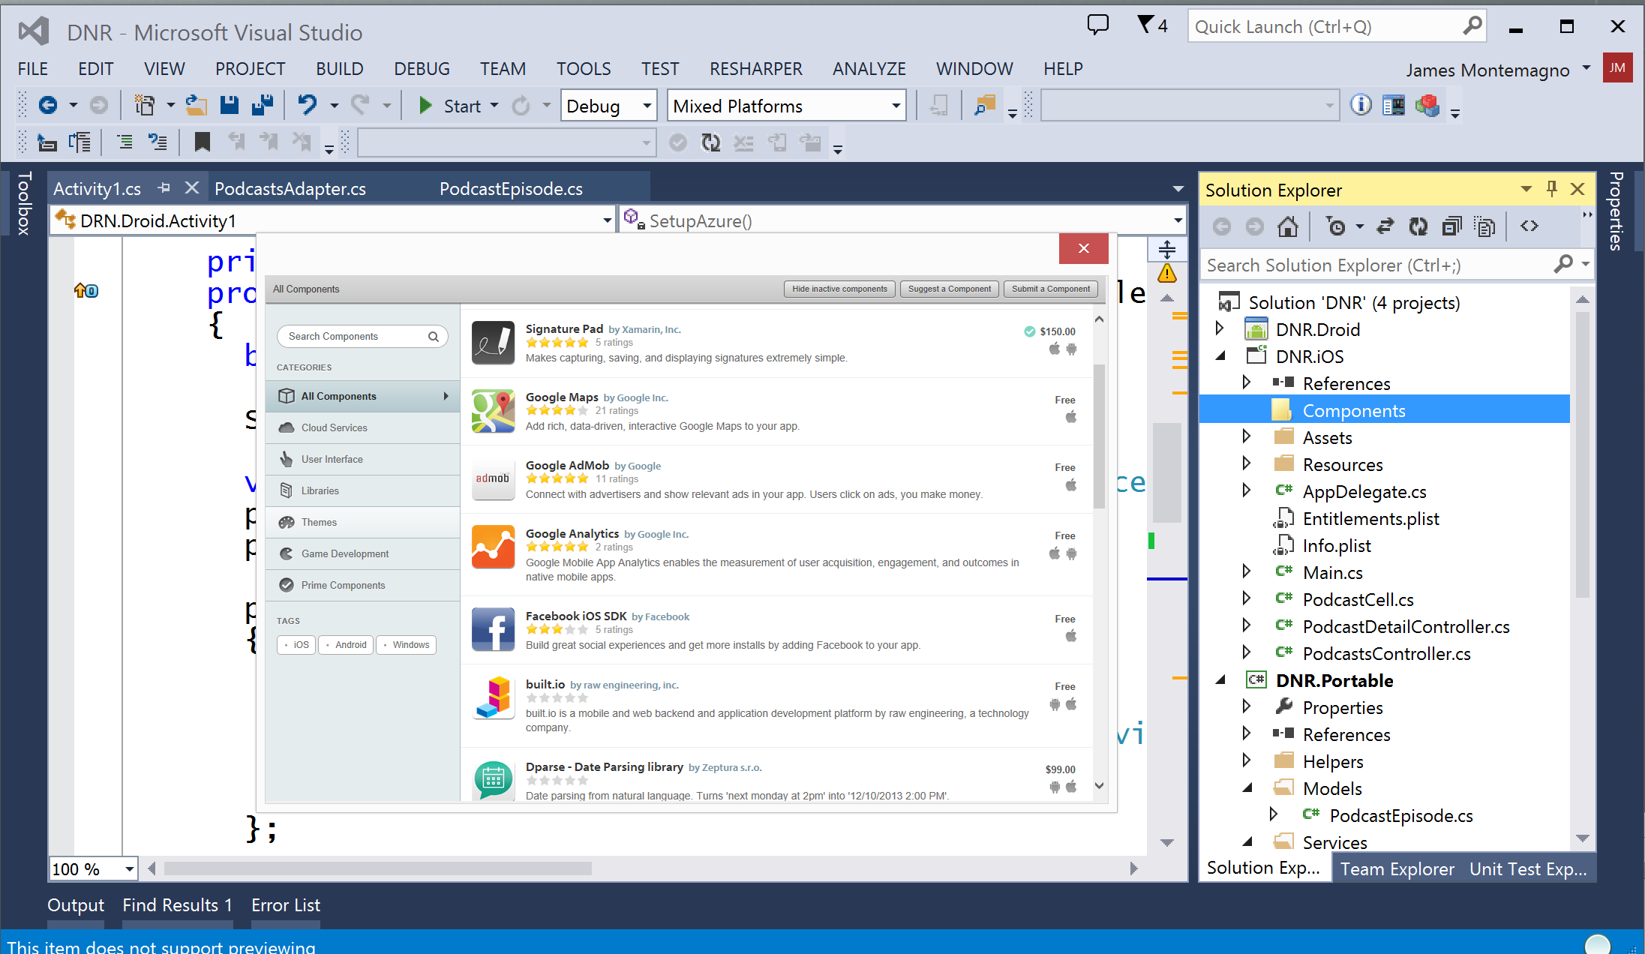
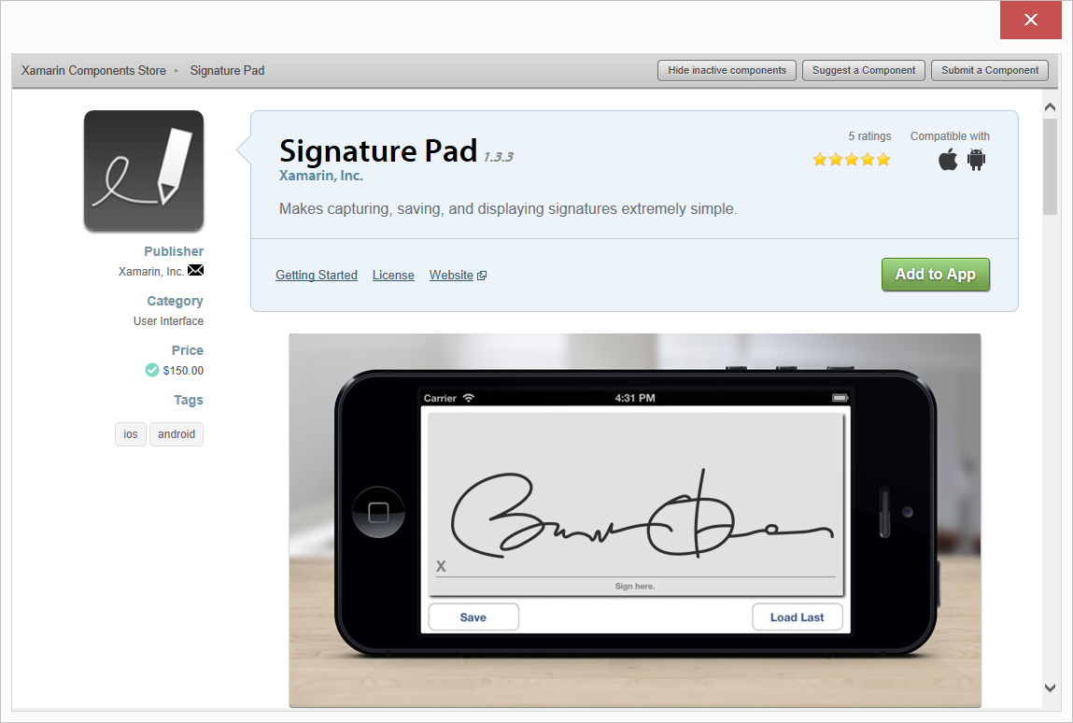
Xamarin Component Store
Build Apps Faster
Add high quality pre-built app components directly from Visual Studio and Xamarin Studio
Beautiful cross-platform UI controls, cloud services and enterprise backend integrations are just a few clicks away
Notes:
Add high quality pre-built app components directly from Visual Studio.
Includes dozens of beautiful UI controls and web services – adding a theme or a 3rd party library is just a few clicks away
Complements existing .NET NuGet ecosystem
Differentiator: focus on UI controls and themes – we are making developers better designers across all platforms

Slide 35

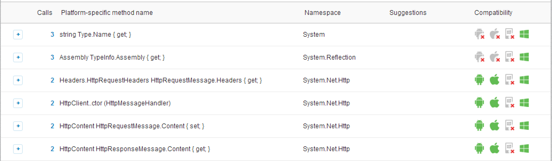
.NET Mobility Scanner
How mobile is your .NET?
Scan .exe or .dll to determine compatibility
Generates full report:
Notes:
Generates a full report of all method calls to determine compatibility with Xamarin.Android, Xamarin.iOS, Windows Phone, and Windows 8.

Slide 36
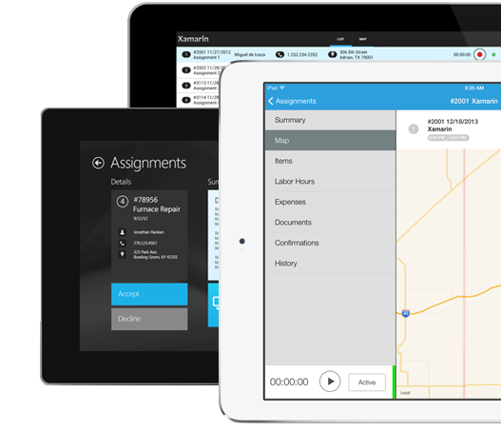
Prebuilt Field Service App
App Features:
Location-based assignments / routing
Time recording
Camera capture of work
Signature capture
Cross-Platform Techniques
MVVM pattern
Xamarin.Mobile
Signature control from Component Store
SQLite for storage on all 3 platforms
Notes:
Open source apps, you can download and get started with today

Slide 37
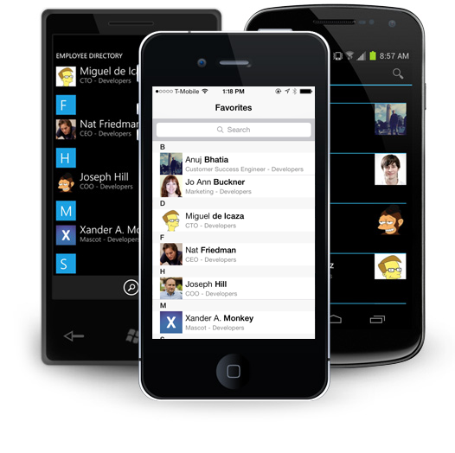
Prebuilt Employee Directory
App Features:
LDAP-ready: easy integration into your corporate directory
Multiple search options
The ability to favorite contacts for easy future access
The ability to call or email right from contact’s listing
Gravatar integration
Notes:
Technical Details
Take advantage of the latest cross-platform UI and mobile architecture best practices, including:
iPhone, Android, and Windows native user interfaces
Uses MVVM, shares view-models across platforms
SQLite data store with a .NET-based SQLite ORM on all platforms
Ability to hook up to your enterprise backend

Slide 38
DEMO
Notes:
Demo time if so desired

Slide 39
Additional Material Remove Slide
Notes:
Additional Resources that might be interesting for your group. Includes: Evolve, Test Flight, Case studies, and Xamarin University.

Slide 40

Xamarin Evolve 2013
#1
Sold Out!!
650
8,400
Trending on Twitter during keynote
Conference Attendees
Live stream hours viewed
Watch Sessions & Highlights: http://xamarin.com/evolve/2013
Notes:
First conference! Huge success
All sessions and highlights are available to stream online!
Great resources

Slide 41

www.xamarin.com/evolve
Notes:
Save the date now available

Slide 42
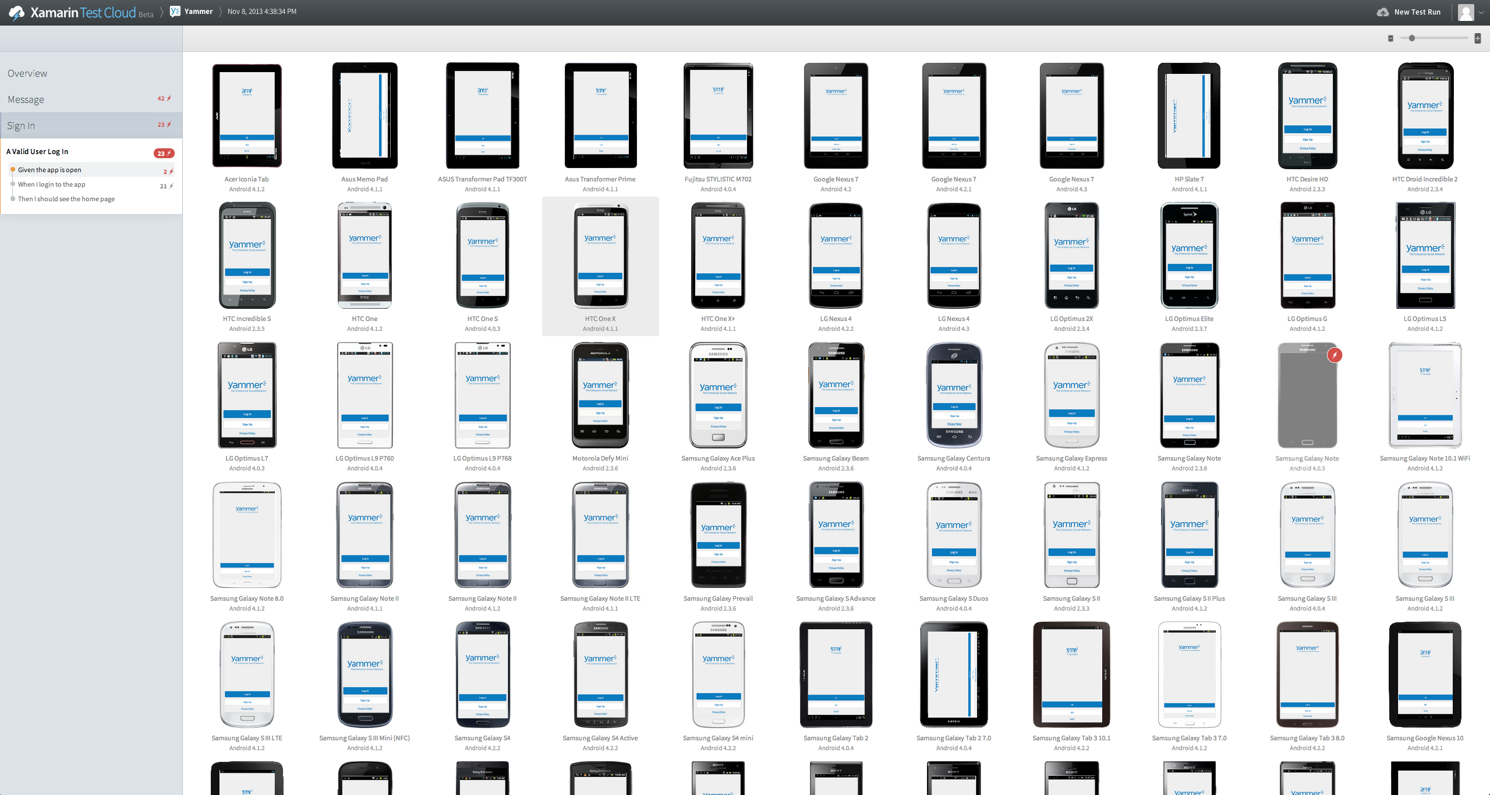
Test app at UI level
Takes minutes, not days to get started
Test on hundreds of real devices
Is resilient to visual changes in UI
Has a delightful user interface
App Explorer & Custom Tests
Notes:
App Explorer - uses one reference device, and runs through all the screens and execution paths. If it dead ends, it starts over. Good for a quick overview of app, but not a replacement for hand-crafted tests.
Statistics
OS Versions,
Devices (sorted by device market share - you can prioritize
Crashs vs. Unique crashes
# of gestures performed
Total device time
Yammer
Left hand window this the tests executed (step by step). On the right hand side you see the devices that the tests were run on. As you scroll through each step, you can see on the right hand side. Drill down on a specific device to see more details.
Types of output
- Visual Test Results (from screenshots) - "I've never seen my app run on a Kindle Fire - it looks terrible"
- Stack Trace and full device log
- Performance Data
- Peak memory usage - show's memory usage at each step of the app
- App Size
- Responsiveness - how long does it take the UI thread to respond. Measured in milliseconds, and roughly equates to FPS.

Slide 43
Rdio Case Study

Slide 44

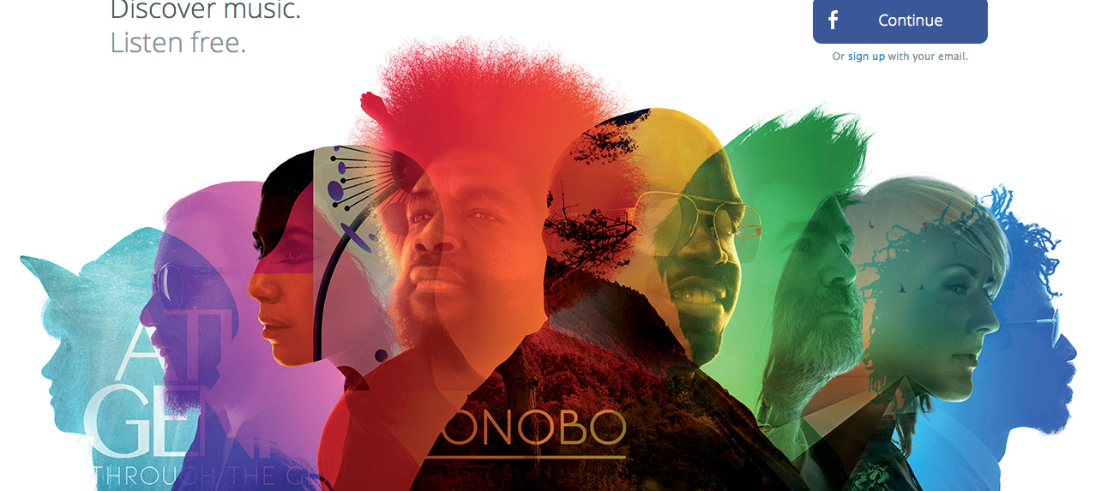
Sharing 50,000 lines of code
About Rdio
Rdio is the leading music streaming and sharing service started by the founders of Skype
Rdio is already in 30 countries with over 20 million songs.
Available in 31 countries
“Rdio’s mobile app is also the best looking and best implemented of the three [music streaming apps reviewed].”
Wired Magazine
Notes:
A consumer music streaming company founded by the guys who founded Skype, 18 million tracks. Millions and millions of users in 17 countries. When we talked to them 3 years ago, they had a problem: three codebases on three platforms, the same app implemented 3 times for iOS, Android and Windows. When they wanted to add a new feature, they had to do it 3x. Now their apps are built on Xamarin and they are sharing >50,000 lines of code on each device, and delivering a gorgeous user experience

Slide 45
Sharing 50,000 lines of code
Challenge
Unable to deliver features on all platforms simultaneously because of multiple, platform-specific code bases
High costs to development and maintain apps
Results
Using Xamarin, Rdio now shares over 50,000 lines of C# across iOS, Android, and Windows, enabling them to focus on feature-parity and user experience.
Notes:
A consumer music streaming company founded by the guys who founded Skype, 18 million tracks. Millions and millions of users in 17 countries. When we talked to them 3 years ago, they had a problem: three codebases on three platforms, the same app implemented 3 times for iOS, Android and Windows. When they wanted to add a new feature, they had to do it 3x. Now their apps are built on Xamarin and they are sharing >50,000 lines of code on each device, and delivering a gorgeous user experience

Slide 46

Sharing 50,000 lines of code
“Xamarin offers the best of all worlds. We deliver high performance, native apps that, until Xamarin, were only possible with Objective-C and Java. Sharing over 50,000 lines of code across platforms gives us more time to spend on great user experiences.”
Matt Crocker
Director of Client Engineering
Notes:
Rdio is "the best looking and best implemented of all three mobile
music apps"

Slide 47
MarketWatch
Case Study

Slide 48


From No Mobile Experience to Quick Success
About Dow Jones MarketWatch
A Dow Jones property with over 16 million visitors per month
Leading innovator in business news, personal finance, and investment tools and data
Part of the Wall Street Digital Network, which includes WSJ.com, Barrons.com among others

Slide 49

From No Mobile Experience to Quick Success
Challenge:
Meet Skyrocketing Mobile Traffic with a Great App
MarketWatch’s high-end users making critical financial decisions demand a fast, easy-to-use app
Web team tasked with building mobile app on tight deadlines, but with no mobile experience
App is very data-intensive - initial attempts with HTML5 couldn’t handle
Notes:
\

Slide 50
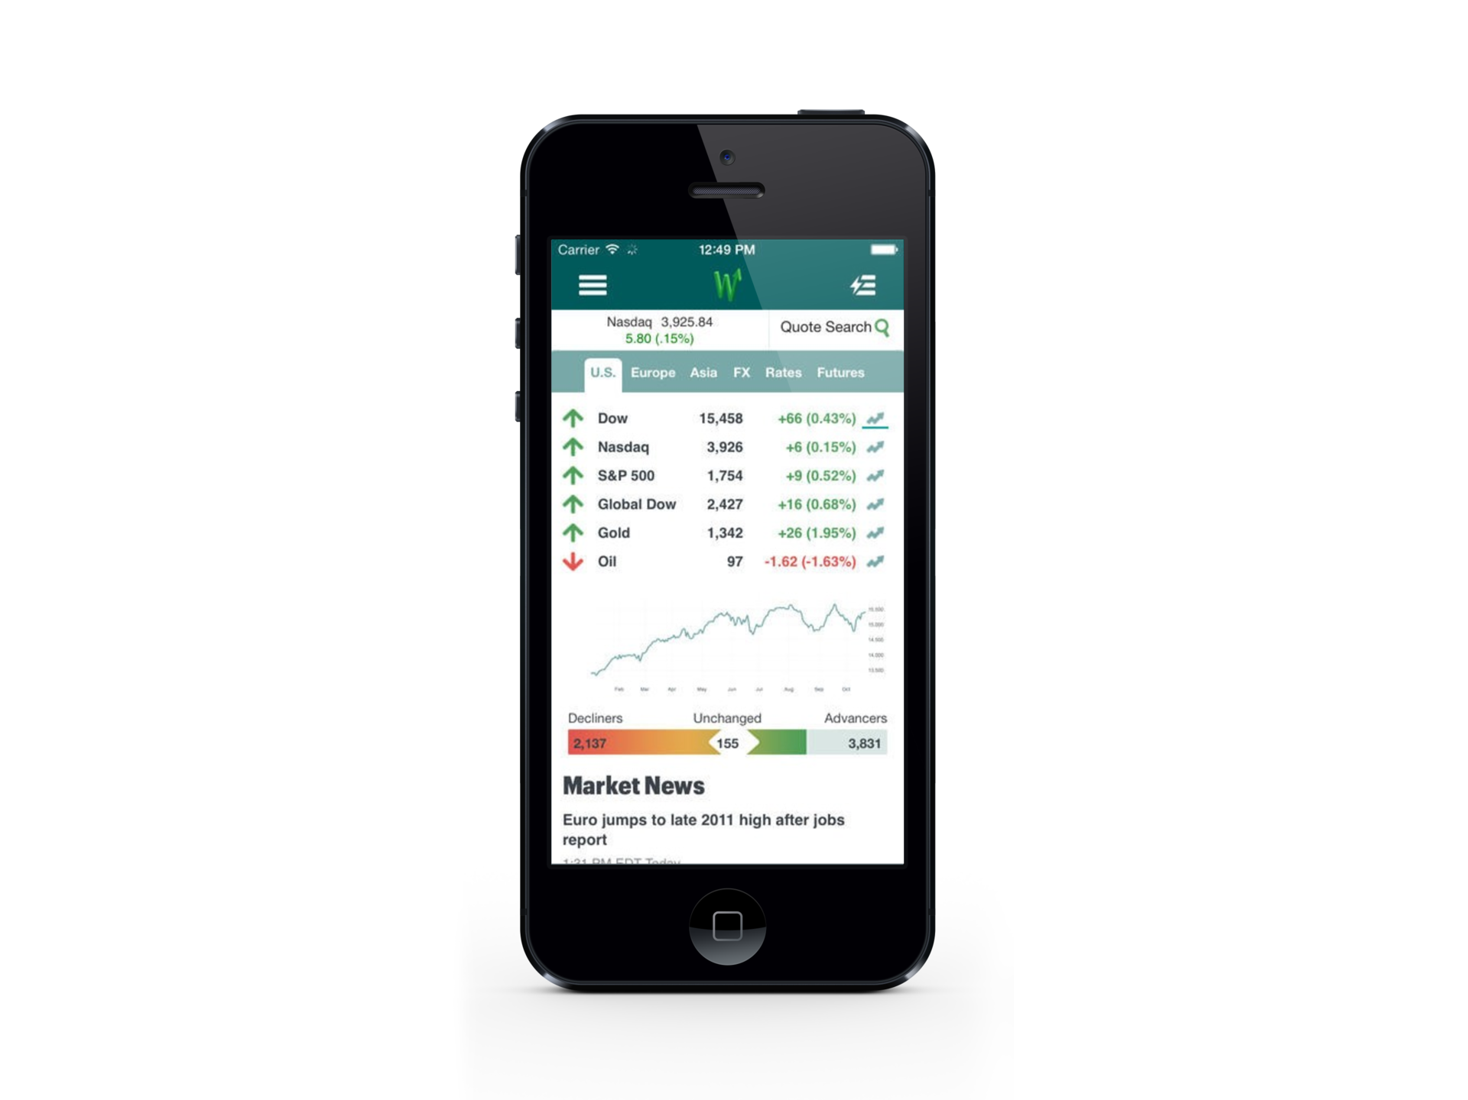
From No Mobile Experience to Quick Success
Results:
With no mobile experience, team leveraged Visual Studio to create native iOS app in 6 months.
Xamarin app replaced existing HTML5 app for better user experience and performance.
Estimated 90% code-sharing with an Android app that is currently in development.

Slide 51
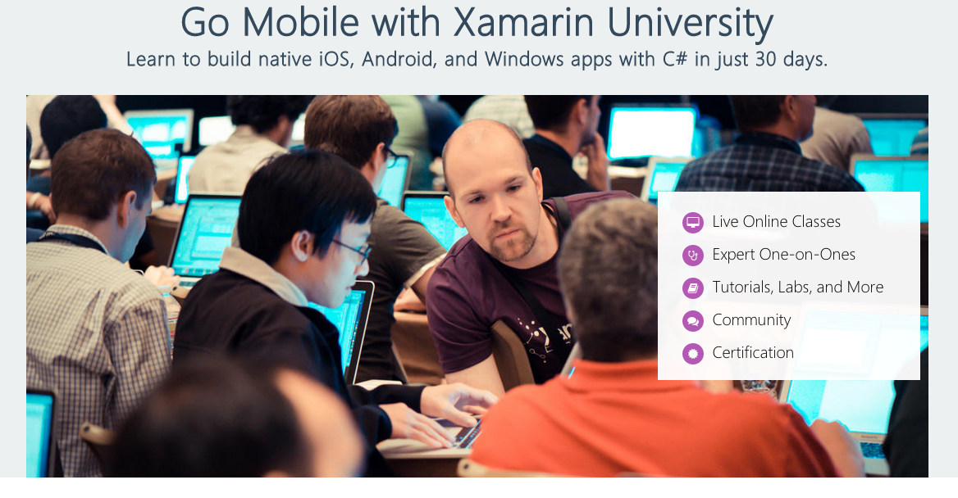
Xamarin University
Go Mobile Program
Live online training from Xamarin experts
Lectures and labs
2 coaching sessions where you meet one-on-one with expert Xamarin mobile developers
What You’ll Learn
iOS and Android Fundamentals
Mobile App Lifecycle
Native UI and Controls
Cross-platform Architecture
Mobile Best Practices
Secure Backend Integration
Notes:
Xamarin University
Learn to build native iOS, Android, and Windows apps with C# in just 30 days.

Slide 52



Xamarin Developer Certifications
Xamarin skills are increasingly in demand – certifications let the market know you represent top talent
Notes:
Xamarin Certification is held online during Xamarin University and also at Evolve Conference.

